Slide 1
Virtual Jewelery Studio:Python based Software for virtual designing and wear on jewelery

Slide 2
Methodology:
User Interface: The UI comprises of three fundamental areas: the virtual jewelry library, the customization board, and the virtual take a stab at window. The virtual jewelry library contains an assortment of various kinds of jewelry, including rings, arm bands, pieces of jewelry, and studios (Ernits, 2020).
Clients can choose the kind of jewelry they need to take a stab at from the virtual jewelry library.
Virtual Jewelry Library:
The virtual jewelry library was made by utilizing PC supported plan (computer aided design) programming.
A group of jewelry fashioners made 3D models of various sorts of Jewelry, which were then brought into the product.
Each piece of jewelry was then doled out an extraordinary identifier, which is utilized to show the chose jewelry in the virtual take a stab at window.

Slide 3

Train the model : During preparing the loads of model are refreshed to limit the misfortune the capability.
Assess the model : During preparing, the loads of the model are refreshed to limit the misfortune capability.
Test the Model : At last, the model can be tried on the testing set to assess its exhibition on new, concealed information.
An illustration of a CNN model design for jewelry identification could be:
Input layer - > Convolutional layer - > Pooling layer - > Convolutional layer - > Pooling layer -> Convolutional layer - > Pooling layer - > Level layer - > Fully Connected layer - > Output layer.

Slide 4

ML Models:
For object recognition, segmentation, and classification in TO studios, machine leaming methods are frequently utilised.
TensorFlow, Keras, and PyTorch are just a few of the machine learning packages available in Python.
Deep learning models are frequently created using Google's well-known machine learning package, TensorFlow.
Another well-liked framework for creating neural networks is called Keras, and it offers a high-level API for creating and training models.
Another machine learning package with capabilities for creating deep learning models is PyTorch, which is frequently used in academic studies.

Slide 5
Model Explanation (CNN Model)
Information importing : This incooperates dividing information into preparing, approval and testing sets.
Feature Engineering : A CNN feature engineering should be planned it have layers.
* Convolutional layers
* pooling layers
* Completed Associated layers
Layers in Model : Includes, choosing Streamlining agent, misfortune capability and assessment metrics
* Streamlining agents utilized in CNN are – Adams and stochastic slope decent.
* misfortune capability relies upon – Picture grouping , downright cross-entropy is used.

Slide 6
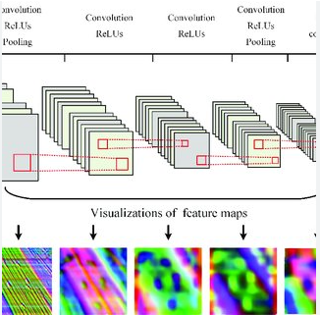
Architecture of CNN Model
The convolutional layers would utilize channels to recognize edges, lines, and shapes in the pictures. The pooling layers would down sample the component maps and lessen the quantity of boundaries in the model. The completely associated layer would utilize the elements removed by the convolutional layers to pursue the last characterization choice.

Slide 7
Processing images:
A VTO studio's image processing is an essential component.
OpenCV, Pillow, and scikit-image are just a few of the image processing libraries available in Python.
Popular image processing and computer vision library OpenCV. It offers a large array of image processing algorithms, such as face detection, object tracking, and image enhancement.
Pillow is frequently used to manipulate images by cropping, resizing, and filtering them.
Another well-known package that offers image processing algorithms, such as edge detection, segmentation, and feature extraction is scikit image.

Slide 8
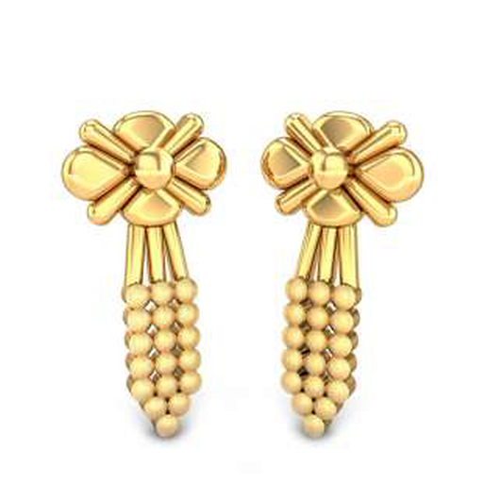
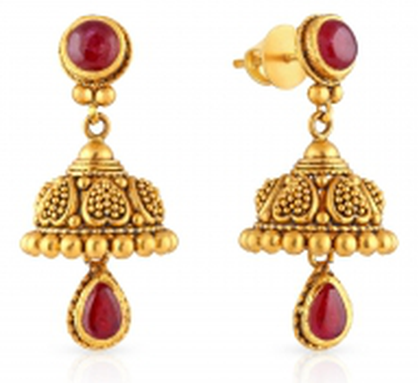
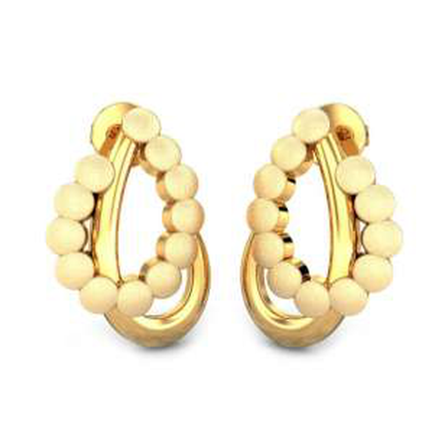
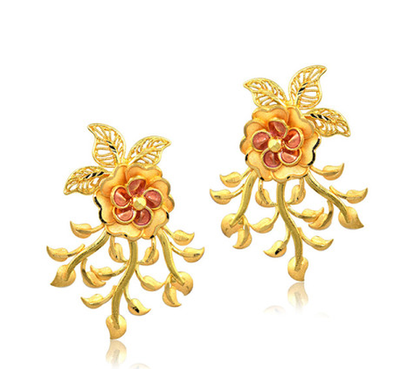
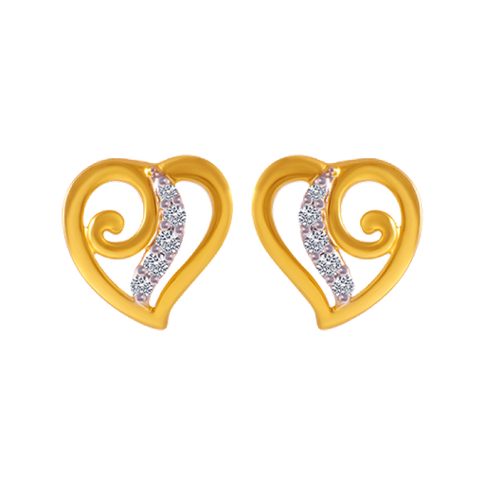
Sample Data sets.

Slide 9
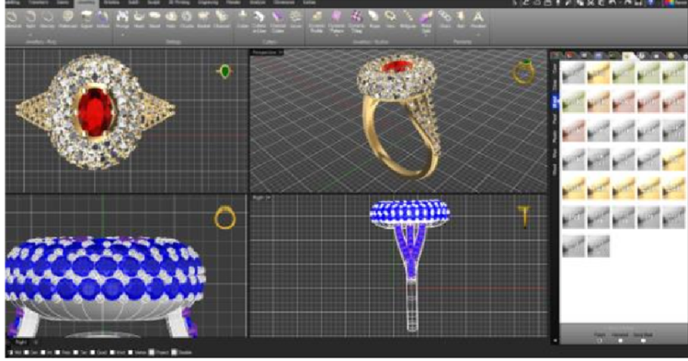
3D- Modelling
A VTO studio's 3D modelling and rendering capabilities are essential because they let clients view products from various perspectives and angles.
Blender, VTK, and PyOpenGL are just a few of the 3D modelling and rendering frameworks available in Python scripts can use the well-liked open-source 3D modelling programme Blender.
Another popular 3D modelling and rendering library used in scientific visualisation is VTK (Young, et al 2021).
A popular graphics package for rendering 3D graphics, PyOpenGL is a Python connector for OpenGL.

Slide 10
Making a 3D model of the jewellery is the first stage in developing a virtual try-on studio for jewellery manufacture.
The next stage is to texture map the 3D model after it has been made.
To give a 3D object a realistic appearance, texture mapping includes adding a 2D picture (texture). Python includes effective texture mapping libraries like Pillow and OpenCV.
Reduced expenditures for physical inventories are one of the advantages.
Customers can use virtual try-on studios to personalise jewellery pieces and see how they will look on them before making a purchase.

Slide 11
Virtual try-on Studio for jewelery:
There are various processes involved in
*including 3D modelling,
*texture mapping,
*lighting, and
*rendering.
Because it offers strong libraries for 3D modelling. like PyOpenGL, Pygame, and Panda3D, Python is a great programming language for creating virtual try-on studios.

Slide 12
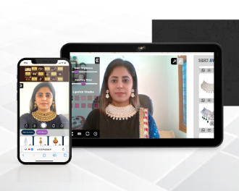
Virtual studio:
The virtual take a stab at highlight was created utilizing PC vision and AI calculations.
The client's webcam is utilized to catch a picture of the client's face, which is then broken down to decide the position and direction of the face.
The virtual Jewelry is then put on the client's face utilizing increased reality methods.
The client can move their head to perceive how the jewelry looks from changed points.

Slide 13
Importing Python Library.

Slide 14
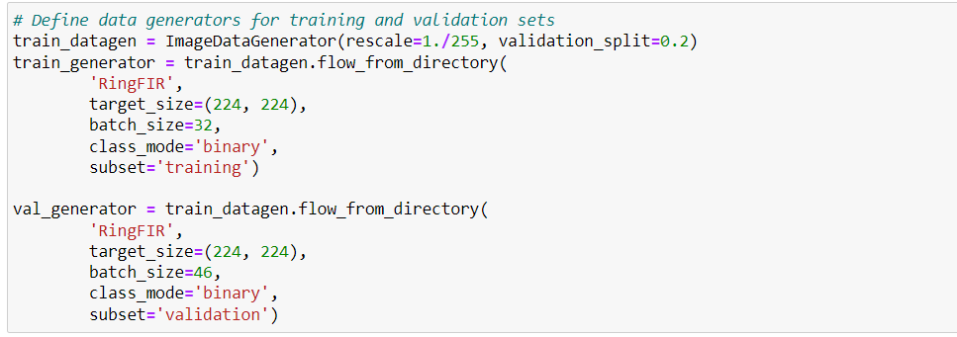
Defining the Data Generators For Training and Validation Sets:

Slide 15
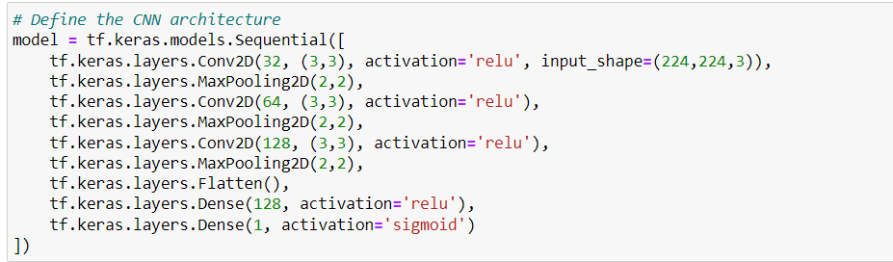
Defining the CNN Architecture

Slide 16
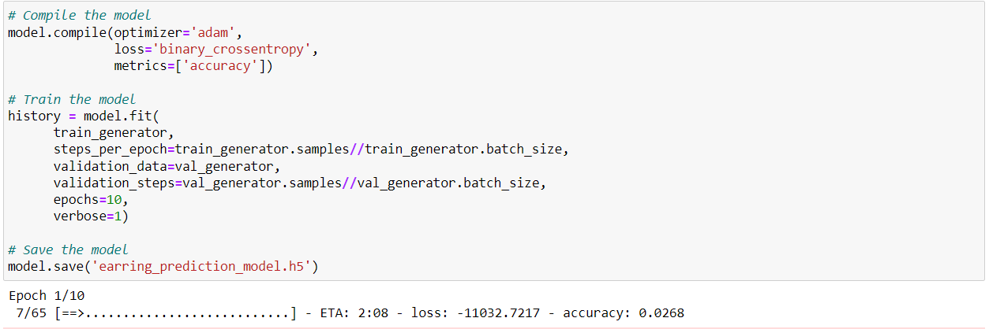
Compile the Model

Slide 17
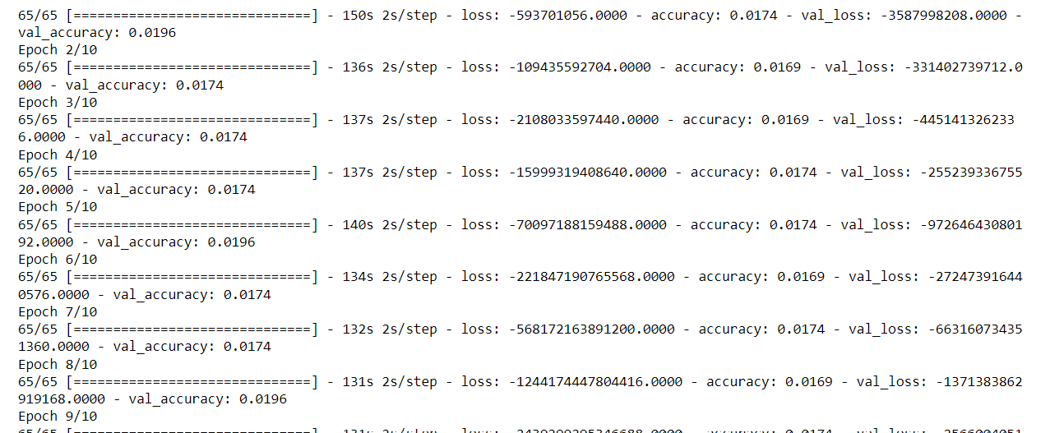

Slide 18
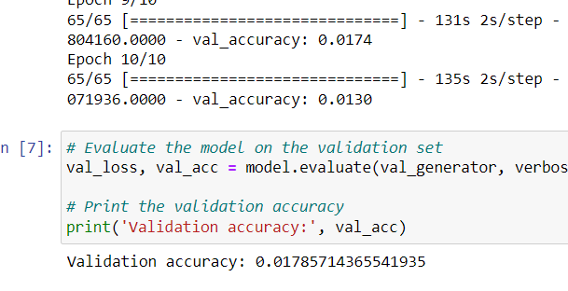

Slide 19
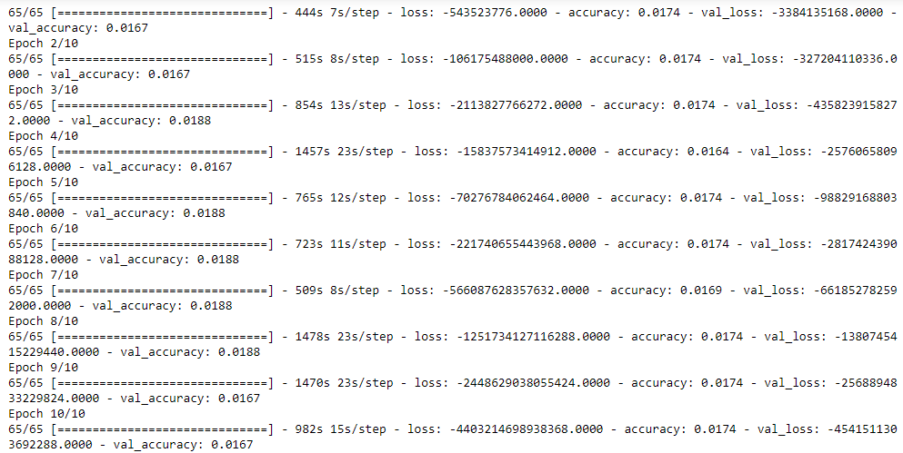
Results and Findings
ML Model is constructed for the detection of the Jewelry type. The Sequential CNN model has been constructed for the detection of jewelry based on the input images. The performance of the detection is measured by using the classification accuracy.

Slide 20
Classification accuracies over epochs: Refer to the performance of a machine learning algorithm on a particular dataset over a series of training iterations. During the training process, the algorithm attempts to minimize the loss function by adjusting the parameters of the model. As the training proceeds, the accuracy of the model on the training and validation sets can be measured and recorded for each epoch.
Typically, the accuracy of the model on the training set increases with each epoch as the model adjusts its parameters to better fit the data. However, the accuracy of the validation set may initially increase but eventually start to plateau or even decrease if the model starts to overfit the training data. Overfitting occurs when the model becomes too complex and starts to fit the noise in the data rather than the underlying patterns.
Therefore, it is important to monitor the classification accuracies over epochs to determine the optimal number of epochs to train the model before it starts to overfit. This can be done by using techniques such as early stopping or regularization to prevent the model from becoming too complex.
Overall, classification accuracies over epochs provide valuable insights into the performance of a machine learning algorithm and can be used to improve the accuracy and generalization of the model.

Slide 21
Thank you

